Slide 1
DOC2VEC
Adham Popal, Jacob Roedel, Samantha Kusner

Slide 2
What is DOC2VEC?
Word2Vec: A family of model architectures and optimizations that can be used to learn word embeddings from large datasets
Continuous bag-of-words model: Predicts the likelihood of a word based on surrounding context words²
Continuous skip-gram model: Predicts words within a certain range before and after the current word in the same sentence
Doc2Vec: Adds a unique document ID to the word vectors, allowing the model to learn document-level embeddings.⁴
Notes:
To understand doc2vec, we first need to understand word2vec… 2 popular algorithm and examples, explain continuous skip-gram model, continuous bag-of-words model is essentially the opposite of the continuous skip-gram model. Doc2vec is word2vec with added vectors

Slide 3
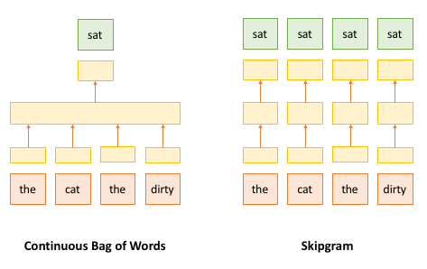

Slide 4
Use Cases of DOC2VEC
NLP:
Extracts semantic meaning from documents and uses that information to classify documents and separate them into various categories
Generative AI
Document Classification/Sentiment Analysis
Real World Application:
Text data representation - document similarity, using doc2vec you can find cosine similarity between two documents easily to:
Find duplicate “documents” on a site like stack overflow
Rank candidate answers for a question answering model⁷
Notes:
Doc2vec is great because it can give that

Slide 5
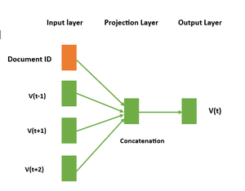
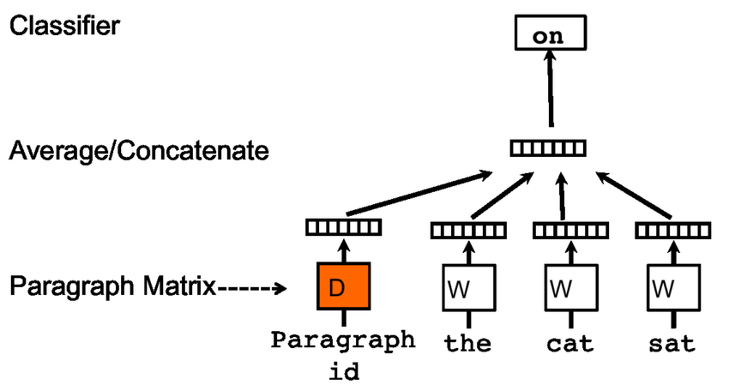
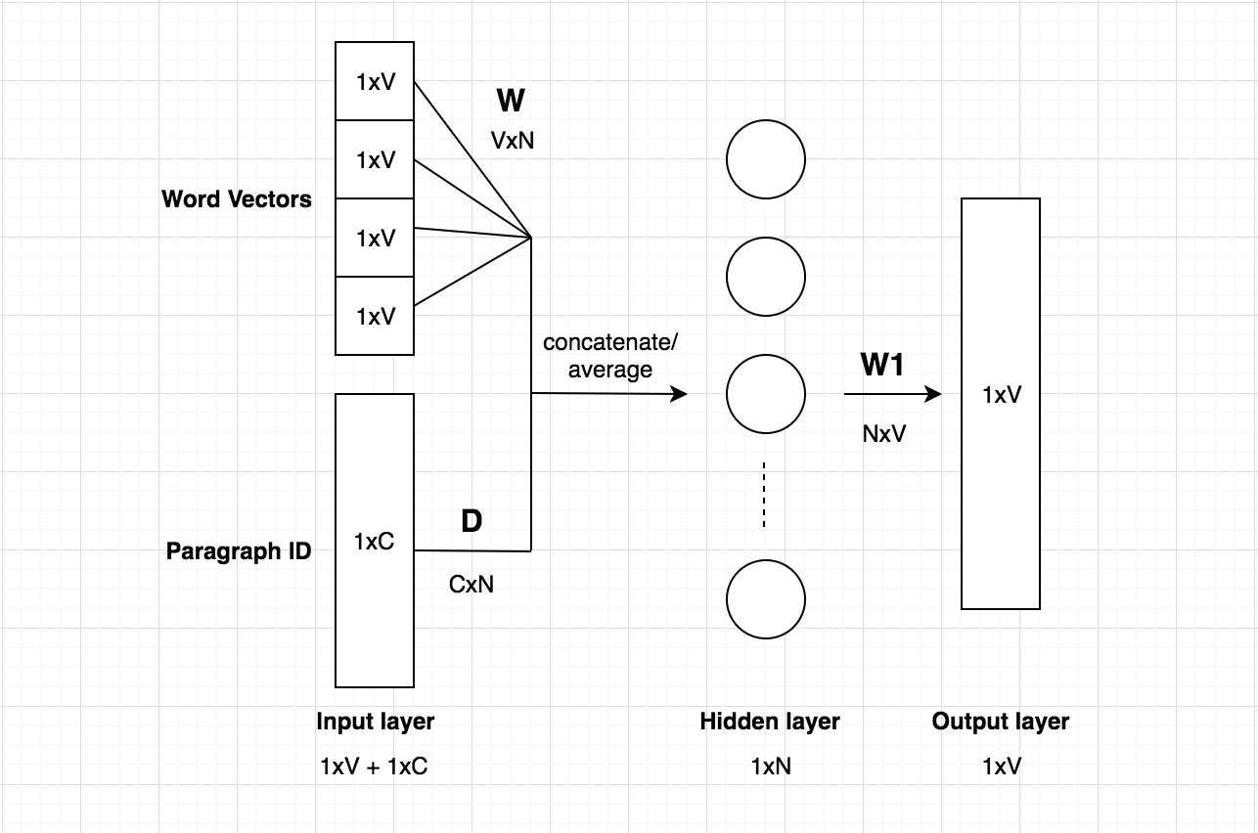
Network Architecture

Slide 6
Our Project
Our Goal:
-Use Doc2Vec model for representing each document in an unsupervised model
-Use final document embeddings to train a classifier for sentiment analysis
Current Model:
-Use Doc2Vec-like embedding to analyze movie reviews and directly determine if they are positive or negative
-Train on 2 datasets and test on a diverse dataset
Notes:
Design Decisions?: Utilize doc2vec for simple sentiment analysis of movie reviews

Slide 7
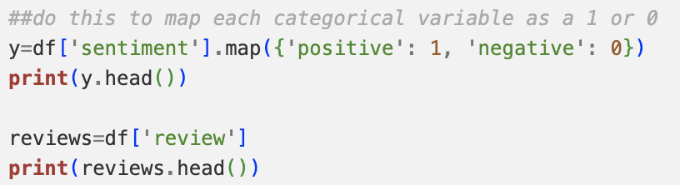
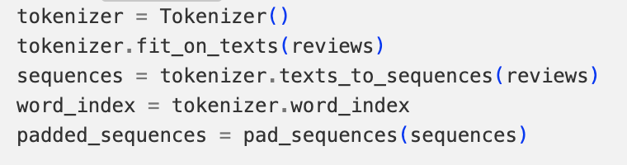
Pre-Processing
Notes:
Design Decisions?: Utilize doc2vec for simple sentiment analysis of movie reviews

Slide 8
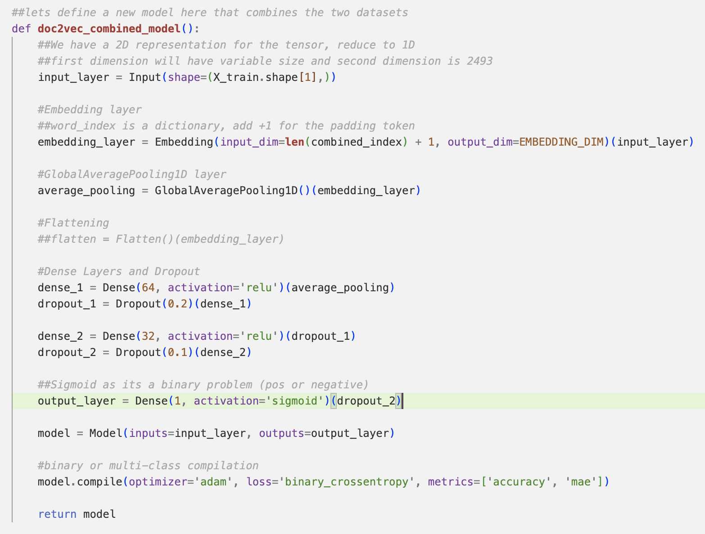
Code Snippet

Slide 9
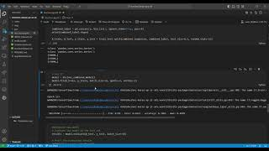
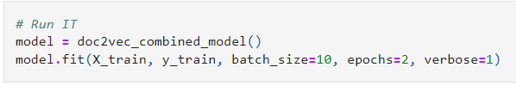
Demo Video
Embedding Dimension = 100

Slide 10
Approaches & Results
Overfitting: Overfitting on the training data itself was our biggest problem
Metrics: 85-90% accuracy on diverse dataset with loss of around 0.25
Datasets: Varying levels of “sentiment” which led us to mix and match datasets
Optimization: Dropout, dense layers, and global pooling
Notes:
Talk about issues of overfitting, splitting dataset with k-fold validation was needed, IMDB dataset was much more clear in sentiment and structured, but we wanted our model to work with more kinds of movies reviews, tried another dataset where the sentiment was less clear cut and more moderate per review, which led us to our first poor model. Used first and second dataset on a much more varying dataset that includes short reviews, and long reviews and much less structure to each review and a larger varying spectrum of sentiment

Slide 11
Doc2Vec Implementation
Tokenize each document
Tag each document with unique ID
Build vocabulary (get all unique words from all text)
Create model (embedding or each vector with additional layers to catch complexity)
Train on it (unsupervised training)
Extract all trained vectors from Doc2Vec model
Split data (train and test)
Line up vectors with labels (positive or negative)
Logistic regression model network (i.e. sigmoid on final dense layer)
Test accuracy

Slide 12
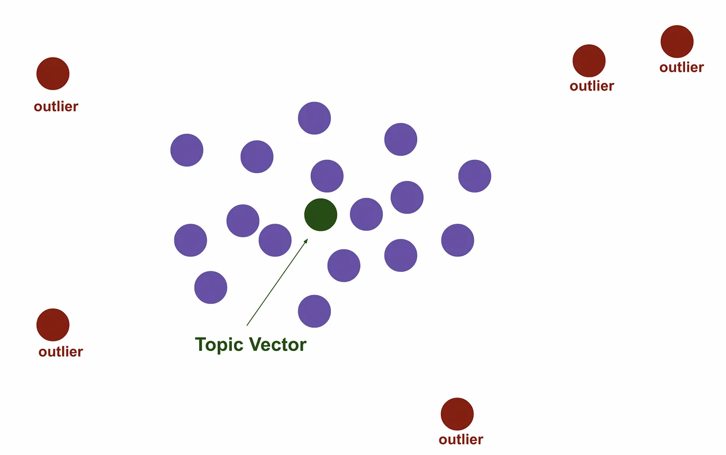
Future Development
Build a Top2Vec Model
Follows a 4 stage architecture
Document Embedding → Use our Doc2Vec model to build and create our own Top2Vec
Low Dimensional Document Embedding
Identify dense areas of documents
Finding the closest word

Slide 13
Thank you!
Any Questions?

Slide 14
References
https://towardsdatascience.com/introduction-to-word-embedding-and-word2vec-652d0c2060fa
https://towardsdatascience.com/nlp-101-word2vec-skip-gram-and-cbow-93512ee24314
https://datascience.stackexchange.com/questions/23638/what-are-real-world-applications-of-doc2vec
https://medium.com/wisio/a-gentle-introduction-to-doc2vec-db3e8c0cce5e
https://www.ibm.com/topics/natural-language-processing
https://towardsdatascience.com/nlp-101-word2vec-skip-gram-and-cbow-93512ee24314
https://medium.com/mlearning-ai/deep-learning-for-nlp-word2vec-doc2vec-and-top2vec-demystified-3842b4fad5c9

